Slide 1
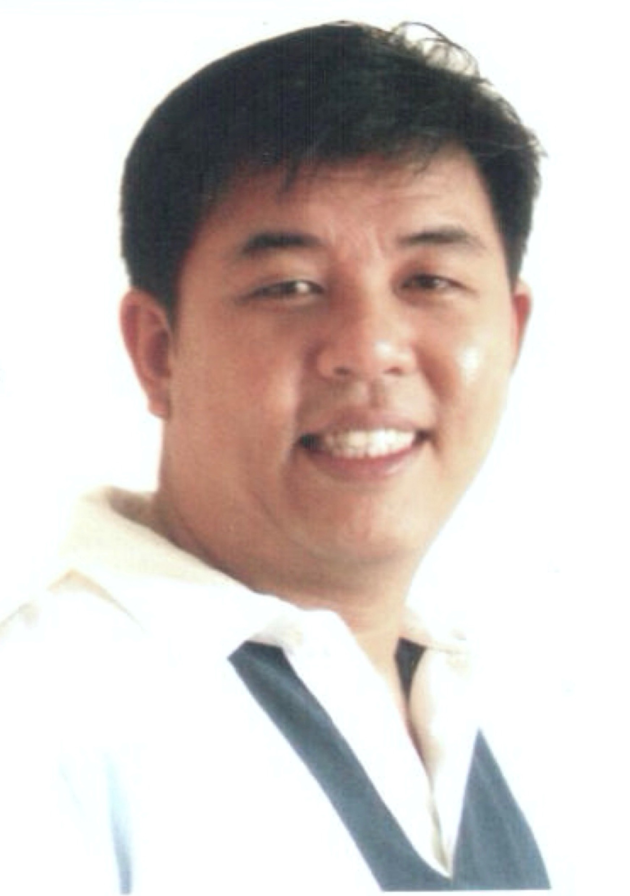
Joseph Ng Infra Tech Support Associate Manager
Insert photo here
Selected Experience
Background
Accenture (IRAS Project) – Cloud Admin
Work closely with a team of architects, engineers, and developers to support functional design specifications, Azure reference architectures, and assist with project deliverables as needed.
Handle and deploy Microsoft Azure Virtual Machines in a highly available environment.
Use JSON templates or script to define and deploy services to Azure, and map custom RBAC role to resources in Azure.
Create custom JSON scripts to control the authorization rights for users.
Work on Microsoft Azure Networking such as NSG, Routing & FW rules to support the network infrastructure.
Gather informative specifications from project team in raising request to the client organization for approval with understanding of each domains or technology. (Network, RBAC, Key Vault, SQL database, Active Directory, Firewall, Kubernetes, Container Registry, Microservices, Virtual Machines and Storage)
Manage and configure Managed Identity (MSI) and Service Principal for authorized enabled Virtual Machine to access the Azure resources.
Provide technical documentations to customer as part of project deliverables.
Seagate Technology International – Senior IT Network and Data Center Manager
Managed and led a technical team of 5 members in designing, implementing, maintaining budget planning and troubleshooting production network infrastructure. Monitored multiple projects development involving expansion, integration, migration, technology upgrade, lab testing, and bug fixes. Engaged and managed vendors service deliverables and expectations. Communicate with upper management and stakeholders.
Senior level IT consultant to Asia Pacific region to support business initiatives as well as best-practice methodologies. Identified, documented and implemented best practices in network configuration and design setup as standard practice. Communicate with regional management stakeholders and HQ.
HP – Senior Network Consultant
Provided IT networking infrastructure solutions design of Cisco, F5, and HP, presented technical and budget proposals, and conducted onsite support.
Joseph has 20+ years of IT networking experiences. He started his career as system and network engineer to a senior network consultant in HP. Later, he became a Senior IT Network and Data Center Manager with consulting role to Asia Pacific regional production sites in Seagate Technology. Currently, he is working on Azure deployment in IRAS.
During his tenure as a consultant, he has worked on projects mainly in the education, government and banking industry. At Seagate, he has worked on projects in leading a technical team in maintaining a reliable and scalable large-scale IT network, integrating and migrating of network infrastructure.
Education
Bachelor of Computer Science
Functional Experience
Industry Experience
Cloud Specialist
IT Network Team Lead
Network Consultant
Manufacturing Industry
Education Industry
Government Industry
Banking Industry
Copyright © 2016 Accenture All rights reserved.
1

